Slide 1
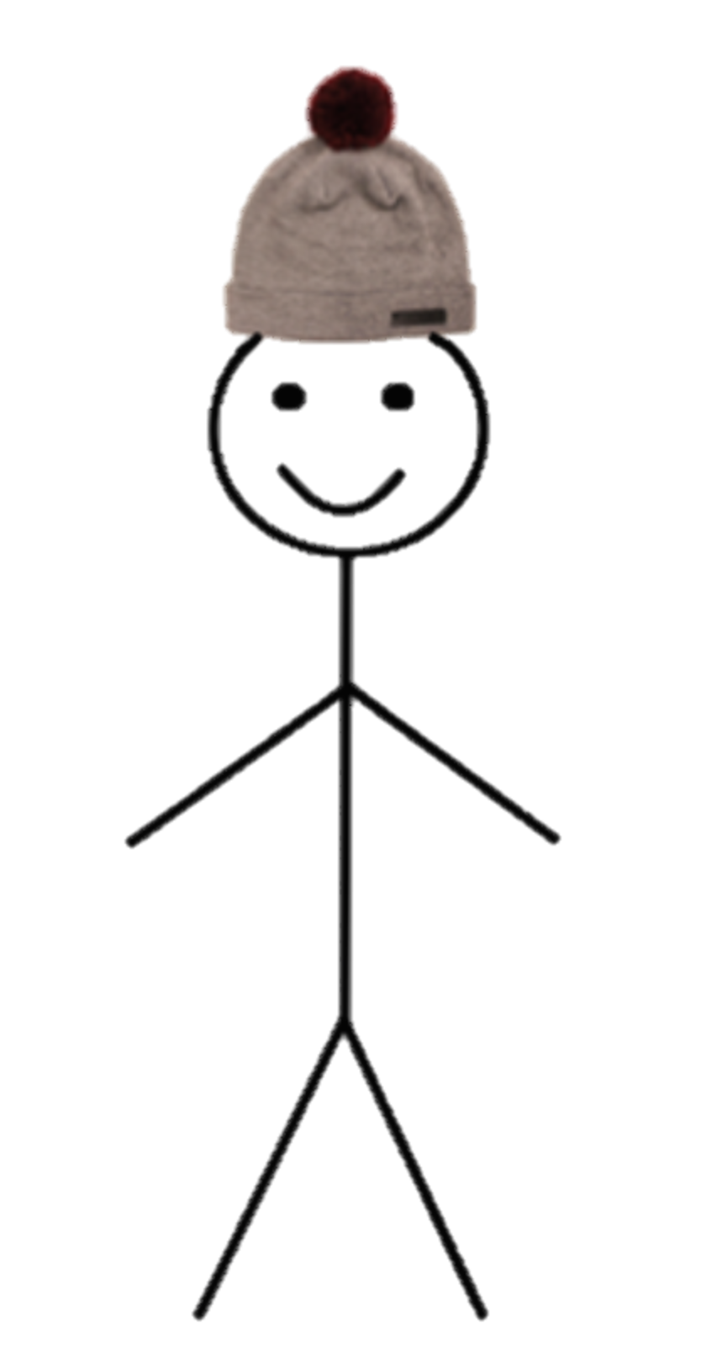
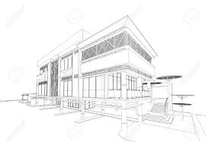
This is Bill.
Bill is an Engineer.
Bill makes things that work, and makes things work better.
Bill is successful.
Be like Bill.
BILL & SONS

Slide 2
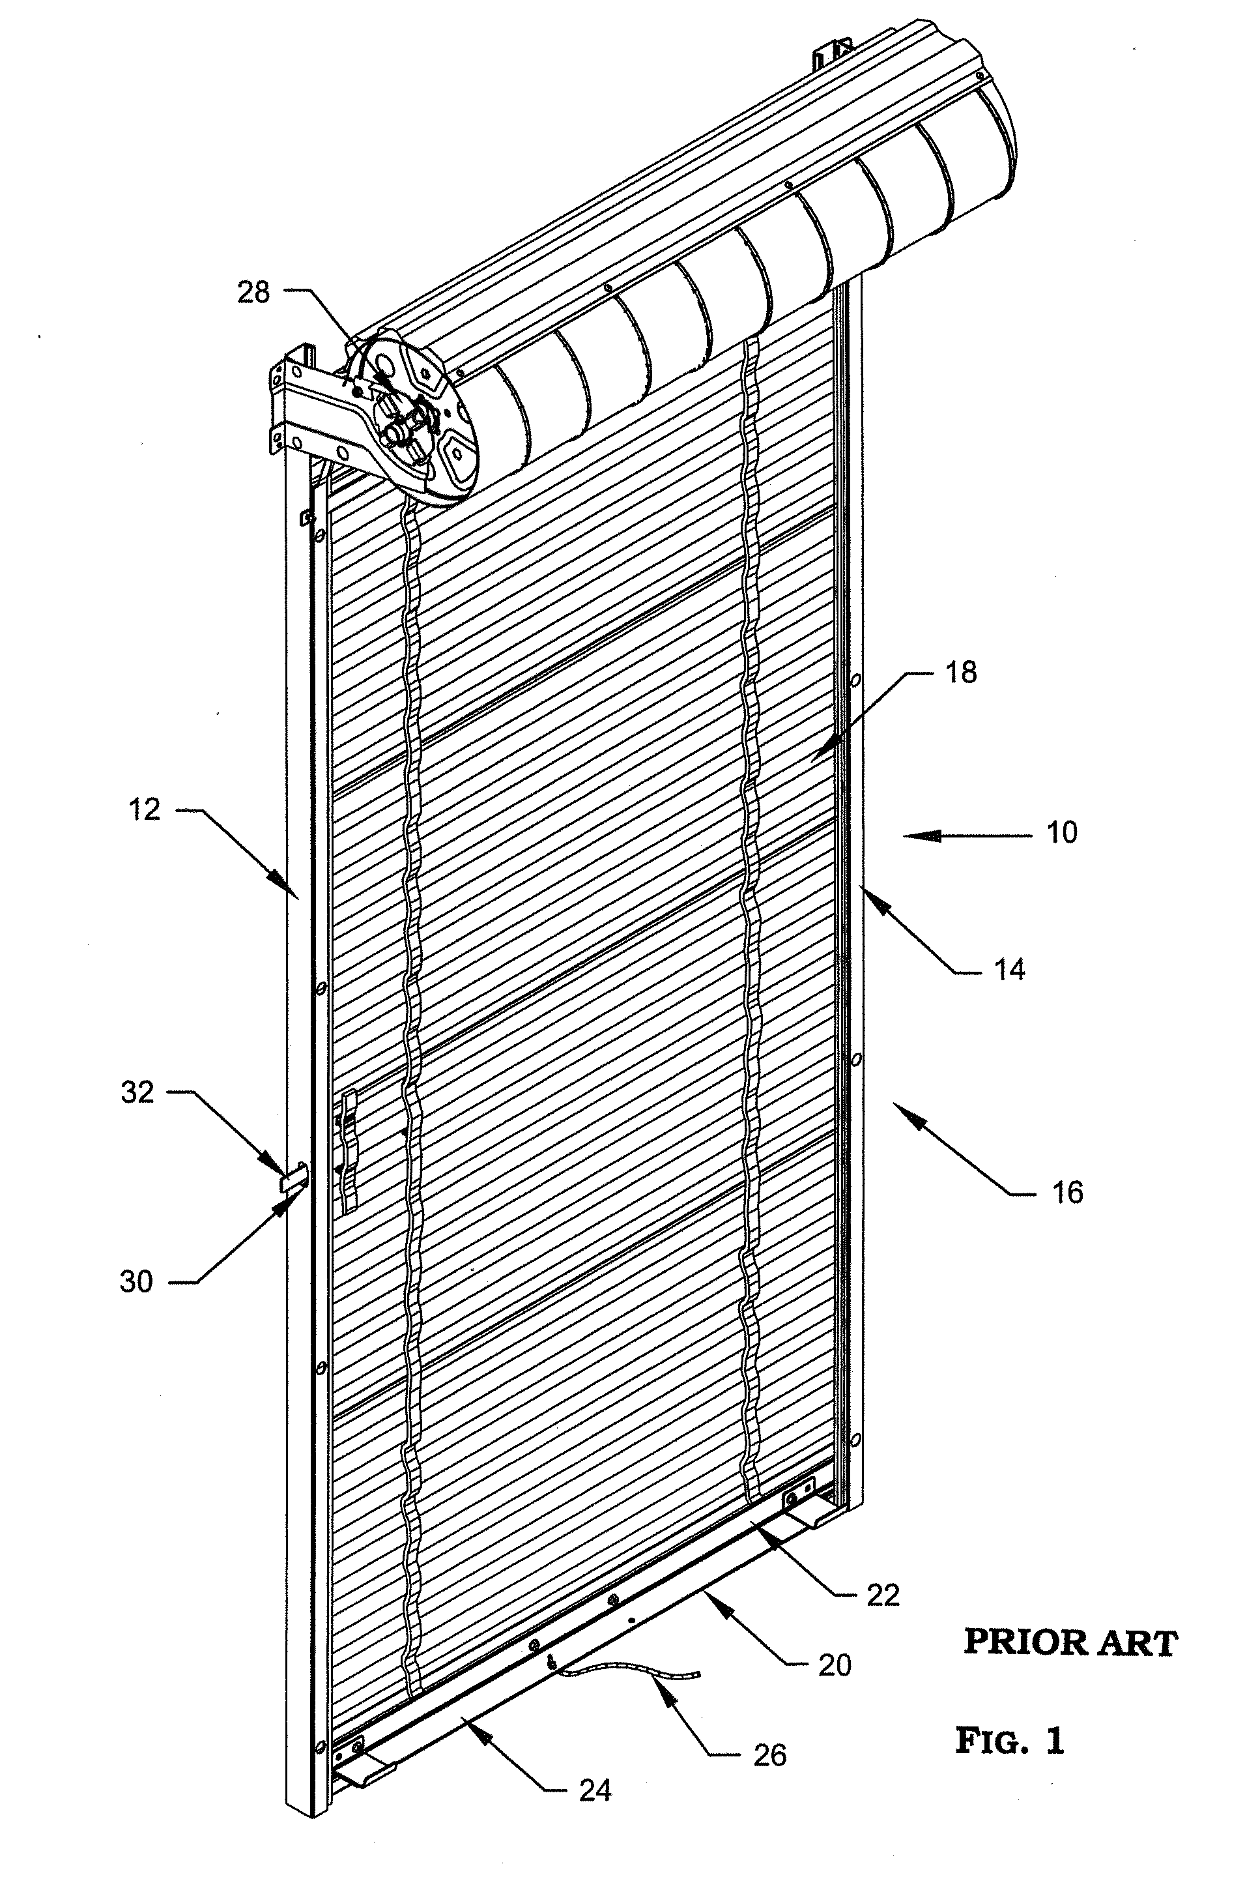
This is Bill.
Bill is a problem finder.
Bill questions the world around him
and verifies what is known.
Bill is an Engineer.
Be like Bill.

Slide 3
This is Bill.
Bill is a systems thinker.
Bill looks for patterns and links between different things.
Bill is an Engineer.
Be like Bill.

Slide 4
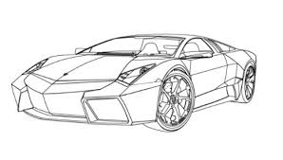
This is Bill.
Bill is a visualiser.
Bill turns abstract ideas into concrete physical products.
Bill is an Engineer.
Be like Bill.

Slide 5
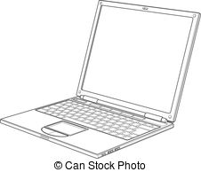
This is Bill.
Bill is an improver.
Bill relentlessly tries to make things better.
Bill is an Engineer.
Be like Bill.

Slide 6
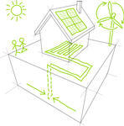
This is Bill.
Bill is a creative problem solver.
Bill is critical and applies techniques from one area to solve problems in another.
Bill is an Engineer.
Be like Bill.

Slide 7
This is Bill.
Bill is an adapter.
Bill reflects and makes changes to the way he does things.
Bill is an Engineer.
Be like Bill.
BILL’s JOURNAL

